Slide 1
CENG 538
Advanced Graphics and UIs
Marching Cubes

Slide 2
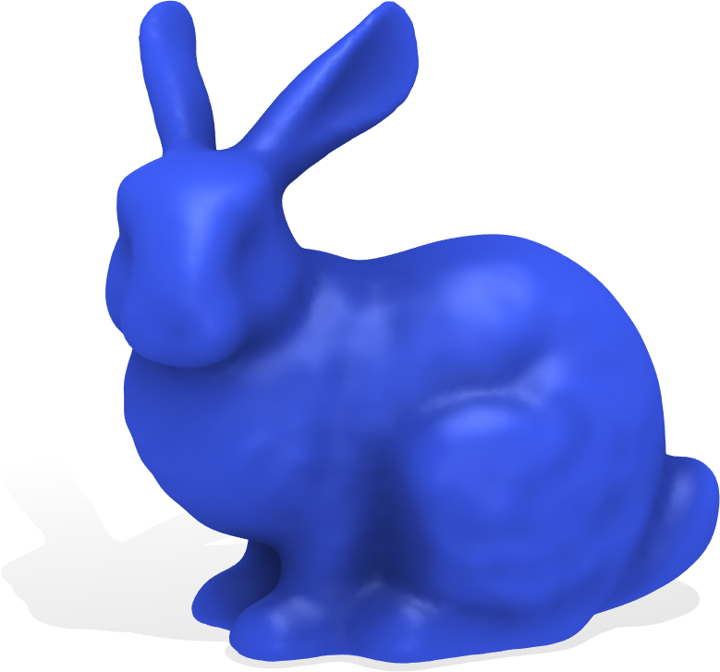
Triangle meshes discretize surfaces…

Slide 3
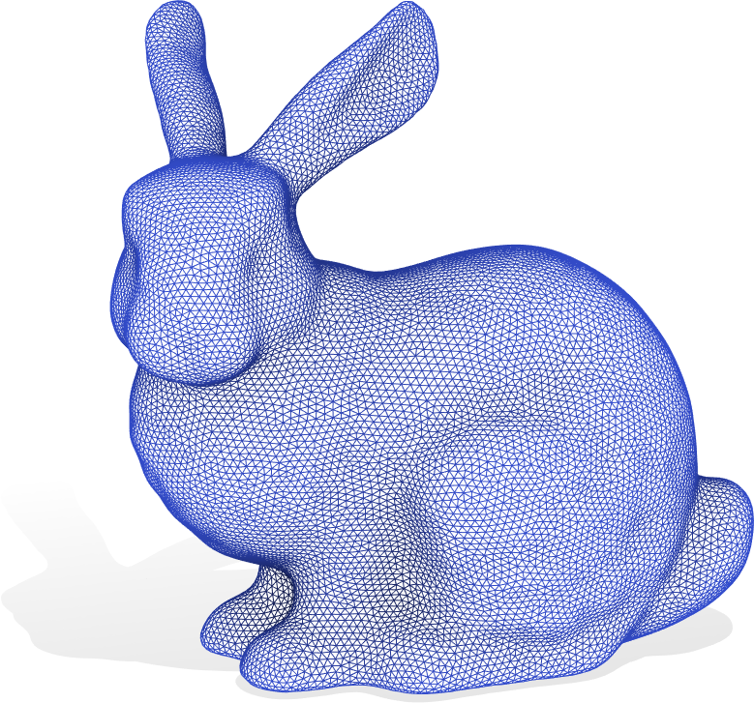
Triangle meshes discretize surfaces…

Slide 4
Triangle meshes discretize surfaces…

Slide 5
Triangle meshes discretize surfaces…
v₁ = [x₁ y₁ z₁]

Slide 6
Triangle meshes discretize surfaces…
v₂ = [x₂ y₂ z₂]
v₁ = [x₁ y₁ z₁]

Slide 7
Triangle meshes discretize surfaces…
v₂ = [x₂ y₂ z₂]
v₁ = [x₁ y₁ z₁]
v₃

Slide 8
Triangle meshes discretize surfaces…
v₂ = [x₂ y₂ z₂]
v₁ = [x₁ y₁ z₁]
v₃

Slide 9
Triangle meshes discretize surfaces…
v₁
v₂
v₃

Slide 10
Triangle meshes discretize surfaces…
f₁ = [1 3 2 ]
v₁
v₂
v₃

Slide 11
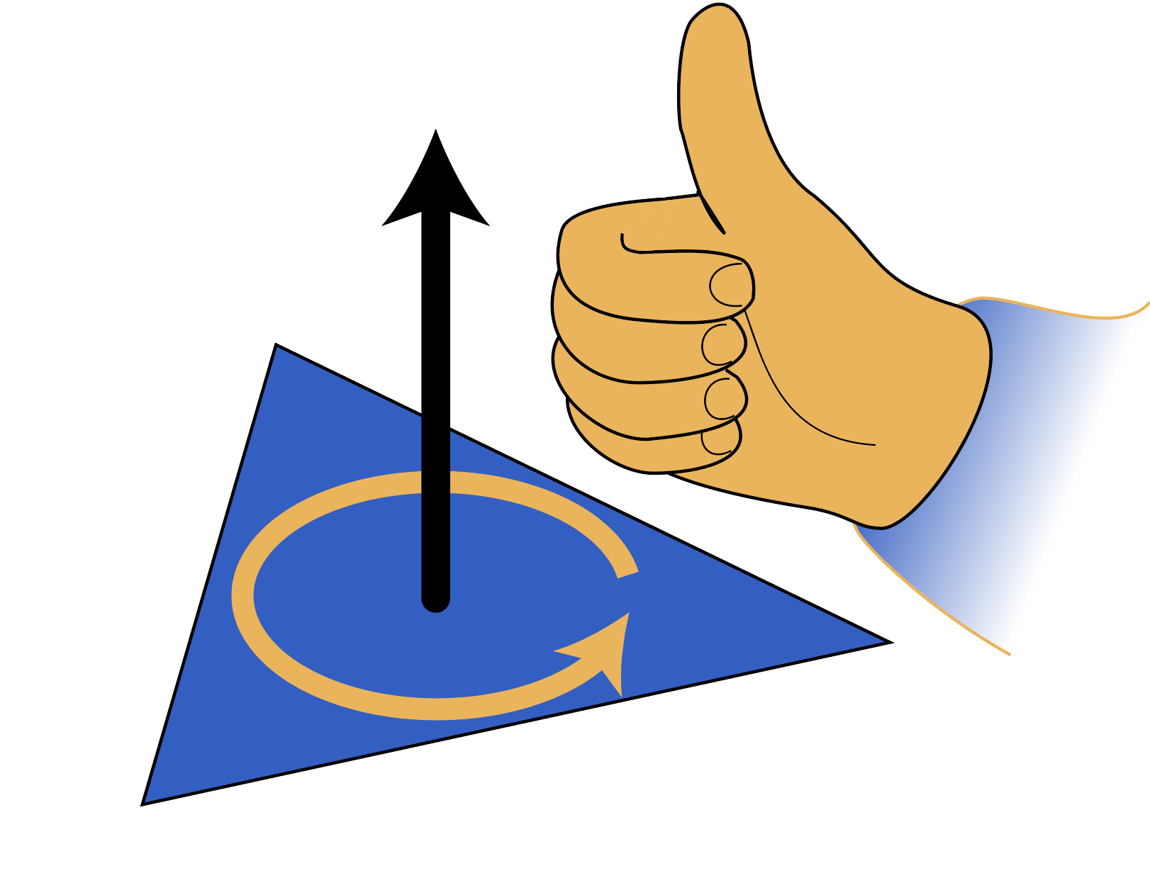
Triangle meshes discretize surfaces…
f₁ = [1 3 2 ]
orientation matters!
v₁
v₂
v₃

Slide 12
Triangle meshes discretize surfaces…
f₁ = [1 3 2 ]
v₁
v₂
v₃

Slide 13
Triangle meshes discretize surfaces…
f₁

Slide 14
Triangle meshes discretize surfaces…
f₁
f₂

Slide 15
Triangle meshes discretize surfaces…
f₁
f₂
f₃

Slide 16
Triangle meshes discretize surfaces…
f₁
f₂
f₃

Slide 17
Indexed face-set data structure

Slide 18
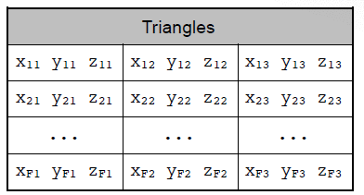
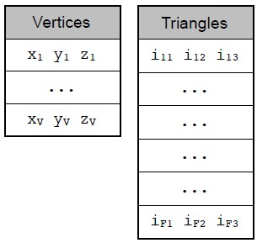
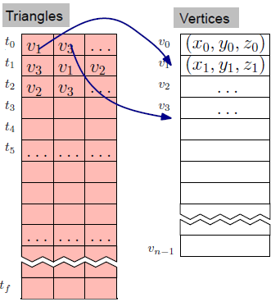
Face-Based Data Structures
<number> / 24
Face-Set data structure. //aka polygon soup ‘cos no connectivity info.
//vertices and associated data are replicated.
Indexed face-set data structure (obj, off, ply formats). Better!!!!

Slide 19
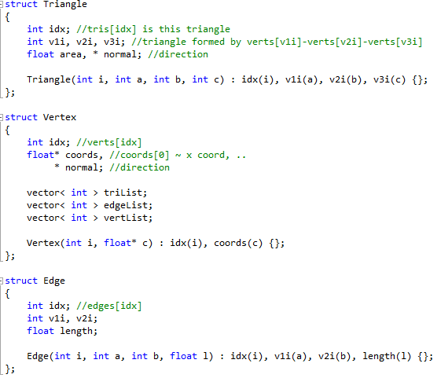
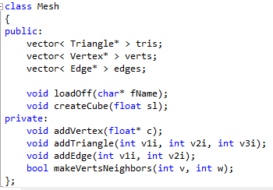
Face-Based Data Structures
<number> / 24
A code sample to set this structure up.

Slide 20
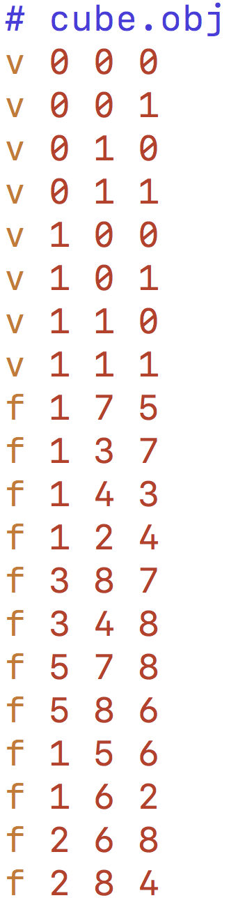
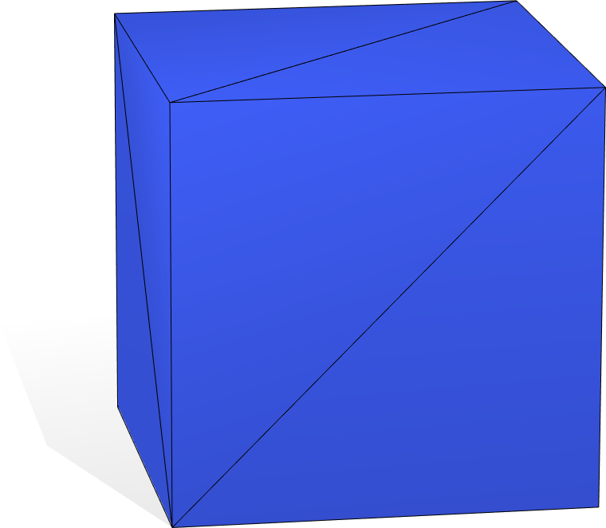
OBJ format (off, ply, stl also popular)

Slide 21
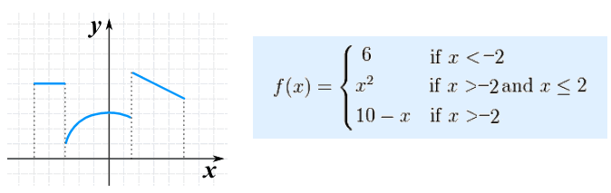
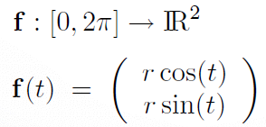
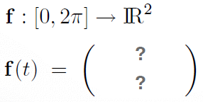
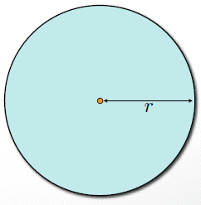
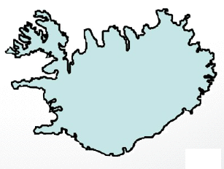
Explicit Representation
<number> / 100
Polygon meshes are piecewise linear surface representations.
Analogous to piecewise functions:
Think surface as (the range of) a “shape” function.
vs.

Slide 22
Explicit Surface Representation
<number> / 100
For varying t, we get 2D shape (circle) points: t in [0, 2pi].
Parameterization f maps a 1D parameter domain, e.g., [0, 2pi], to the curve (surface) embedded in R² (R³).

Slide 23

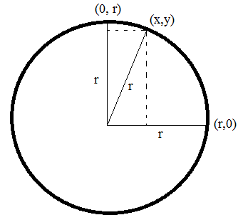
Implicit Surface Representation
<number> / 100
Implicit or Volumetric surface representation.
Surface is defined to be the zero-set of a scalar-valued function F.
  That is, we have , and then surface .
  Circle of radius r:
  is defined by (x,y) pairs
  that make the right-hand-side 0

Slide 24

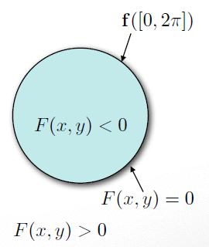

Explicit vs. Implicit
<number> / 100
Explicit:
  Range of a parameterization function.
Implicit:
  Kernel of an implicit function.

Slide 25
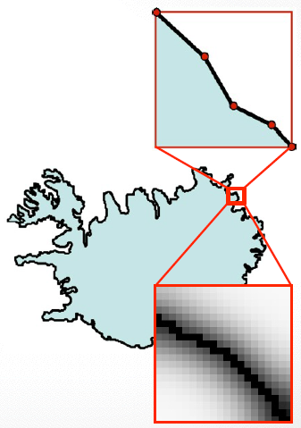
Explicit vs. Implicit
<number> / 100
Explicit: for non-mathematical/arbitrary shapes. (direct point)
  Range of a parameterization function.
  Piecewise approximation.
Implicit: for non-mathematical/arbitrary shapes.
  Kernel of an implicit function.
  Piecewise approximation.
  (zero-set)

Slide 26
Explicit vs. Implicit
<number> / 100
Explicit:
  Range of a parameterization function.
  Piecewise approximation.
  Splines, triangle meshes, points.
  Easy rendering.
  Easy geometry modification (new t = new sample).
Implicit:
  Kernel of an implicit function.
  Piecewise approximation.
  Scalar-valued 3D grid (mesh lies here).
  Easy in/out test (just evaluate F).
  Easy topology modification.

Slide 27
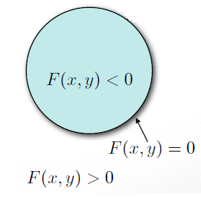
Implicit Surfaces
<number> / 100
Level-set of a function defines the shape.
Level means function values are the same = at the same level. Traditionally, level is 0, hence 0-set of the function F is sought.

Slide 28
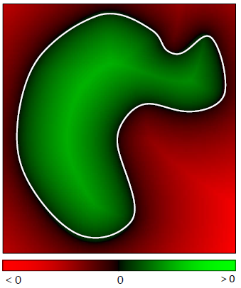
Implicit Surfaces
<number> / 100
Level-set of 2D function F(x, y) defines 1D curve.

Slide 29
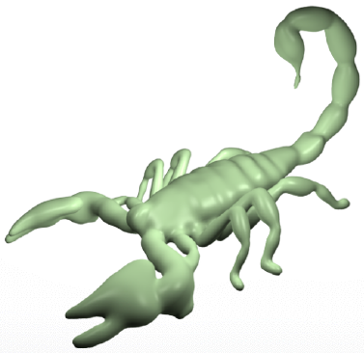
Implicit Surfaces
<number> / 100
Level-set of 3D function F(x, y, z) defines 2D surface.

Slide 30

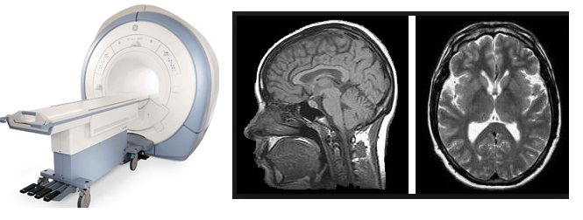
Implicit Function F
<number> / 100
Most common and natural representation is Signed Distance Function.
Maps each 3D point x to its signed distance F(x) from the surface.
Sign indicates inside/outside. F(x)=0 means x is on the surface.
Other than SDF, continuous intensity function from CT/MRI scans are also popular. Here we will focus on the computation of SDF as it is a geometric problem. CT/MRI devices provide intensity information with their underlying radiologic technology.

Slide 31
Implicit Function F
<number> / 100
Most common and natural representation is Signed Distance Function.
Maps each 3D point x to its signed distance F(x) from the surface.
Sign indicates inside/outside. F(x)=0 means x is on the surface.
Other than SDF, continuous intensity function from CT/MRI scans are also popular. Here we will focus on the computation of SDF as it is a geometric problem. CT/MRI devices provide intensity information with their underlying radiologic technology.
  Intensity: amount of vibration caused by magnets in MRI (no radiation).
  Intensity: x-rays (x radiation) are beamed & received along the tunnel in CT.

Slide 32
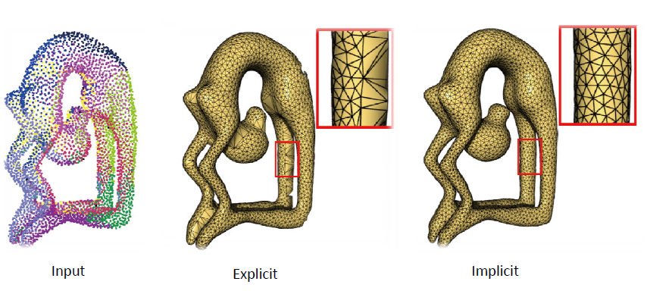
Surface Reconstruction
<number> / 100
Given a set of 3D points, compare Explicit vs. Implicit reconstruction.
Why is implicit better?

Slide 33

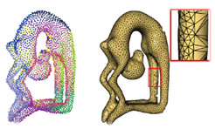
Surface Reconstruction
<number> / 100
Given a set of 3D points, compare Explicit vs. Implicit reconstruction.
Explicit reconstruction method:
  Connect sample points by triangles.
  Exact interpolation of sample points.
  Bad for noisy or misaligned data (common in scans).
  May lead to holes or non-manifoldness.

Slide 34
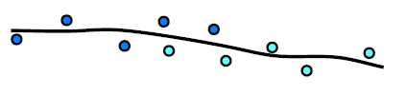
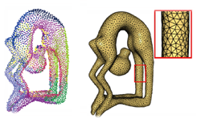
Surface Reconstruction
<number> / 100
Given a set of 3D points, compare Explicit vs. Implicit reconstruction.
Implicit reconstruction method:
  Estimate signed distance function (SDF) for each grid point (scalar-valued grid).
  Extract level zero iso-surface from this grid (Marching Cubes).
  Approximation of input points (better in noisy situations).
  Manifoldness by construction.

Slide 35
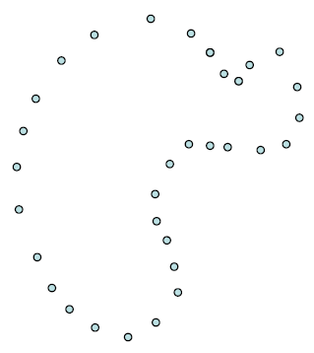
Implicit Reconstruction
<number> / 100
Implicit function approach.

Slide 36
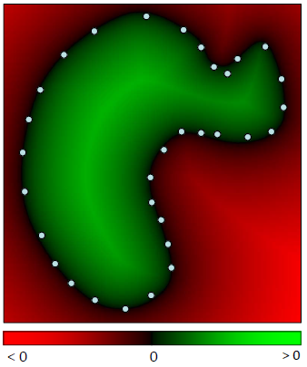
Implicit Reconstruction
<number> / 100
Implicit function approach.
Define a function F : R³ → R with value <0 outside, >0 inside, =0 on.

Slide 37
Implicit Reconstruction
<number> / 100
Implicit function approach.
Extract the zero-set isosurface, i.e., S = {x in R³ | F(x) = 0 }.

Slide 38
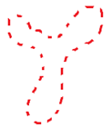
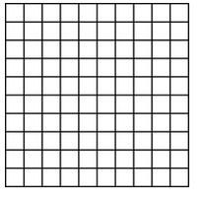
Implicit Reconstruction
<number> / 100
Implicit function: Signed distance function F : R³ → R.
Construction algorithm.
  Input: point samples representing the object to be reconstructed.
  Output: F value at each grid point, i.e., signed distance of that grid pnt to the sampled surface.

Slide 39
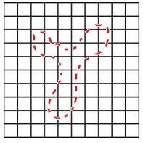
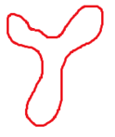
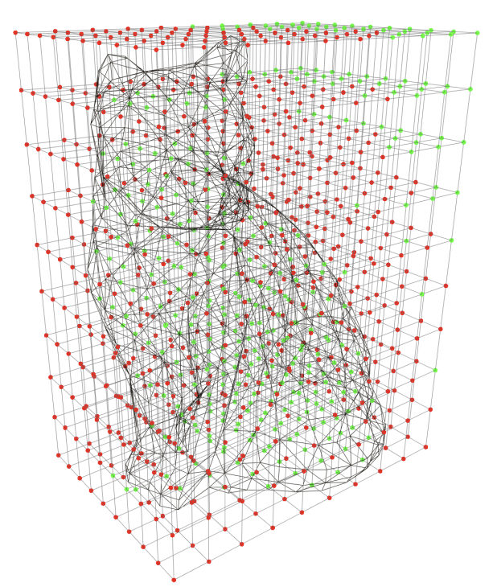
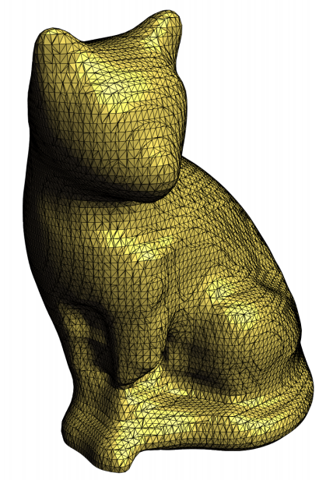
Implicit Reconstruction
<number> / 100
So we need a grid that encapsulates the sampled surface.
Uniform 2D grid.
  Mesh to be extracted: 1D (closed) curve →
Uniform 3D grid.
  Mesh to be extracted: 2D (closed) surface →→→→

Slide 40
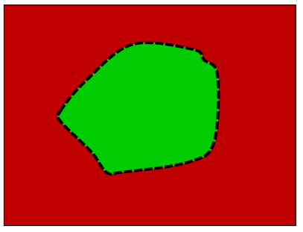
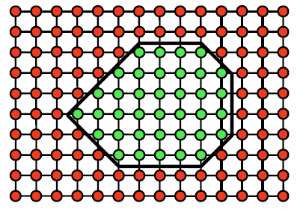
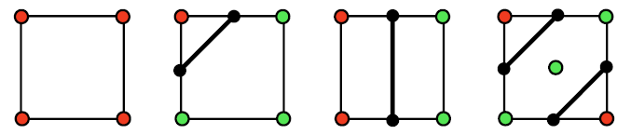
Marching Squares
<number> / 100
Mesh extraction idea.
Marching Squares (2D), Marching Cubes (3D).

Slide 41
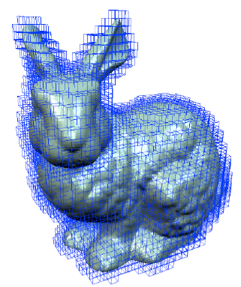
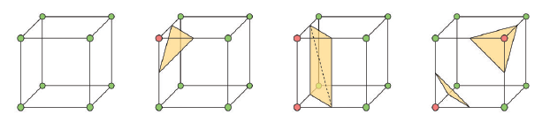
Marching Cubes
<number> / 100
Mesh extraction idea.
Marching Squares (2D), Marching Cubes (3D).

Slide 42
Marching Cubes
<number> / 100
Steps for Marching Squares/Cubes
  Discretize space (use a regular grid enclosing the surface)
  Evaluate signed distance function on grid
  Classify grid points (inside/outside w.r.t. surface)
  Classify grid edges (one endpoint inside, one outside)
  Compute intersections
  Connect intersections

Slide 43
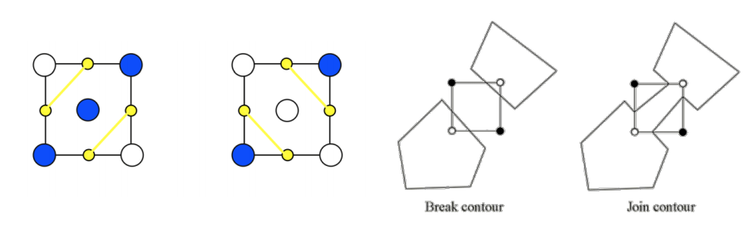
Marching Cubes
<number> / 100
Steps for Marching Squares/Cubes
  Discretize space (use a regular grid enclosing the surface)
  Evaluate signed distance function on grid
  Classify grid points (inside/outside w.r.t. surface)
  Classify grid edges (one endpoint inside, one outside)
  Compute intersections
  Connect intersections (ambiguities may arise)
  Handle by subsampling inside a cell, or randomly picking 1 of the 2 possibilities

Slide 44
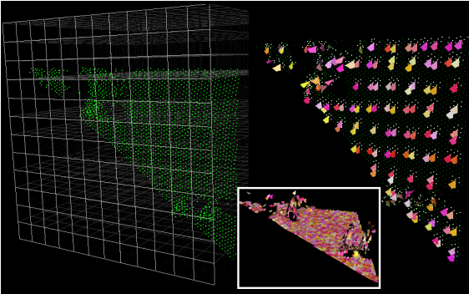
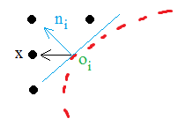

Marching Cubes
<number> / 100
Back to the construction of the Signed Distance Function F : R³ → R.
Input: sample points.
Output: F value at each grid point.
Algo:
  Associate a tangent plane with each sample point.
    Why? Tangent planes are local linear approximations to the surface.
  Compute F(x) = (x - o_{i}) n_{i}

Slide 45
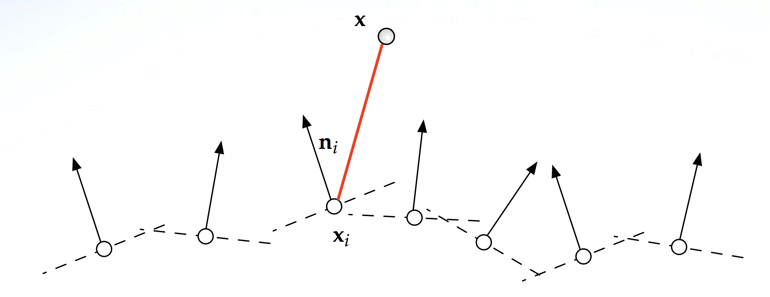
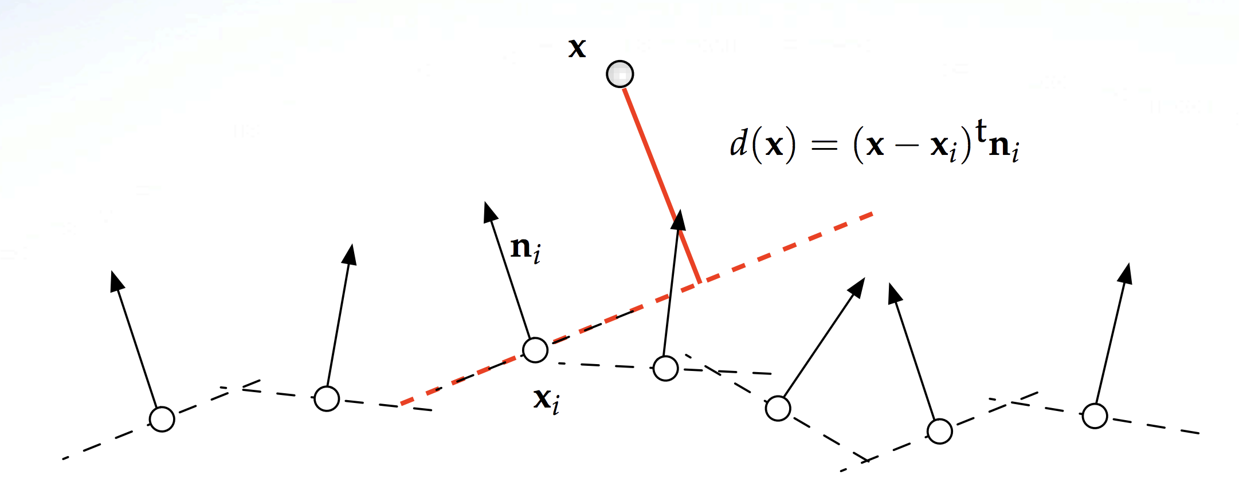
Marching Cubes
<number> / 100
Back to the construction of the Signed Distance Function F : R³ → R.
Input: sample points.
Output: F value at each grid point.
Algo:
  Compute F(x) = (x - o_{i}) n_{i}

Slide 46

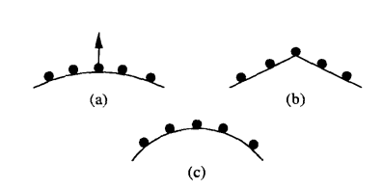
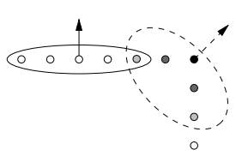
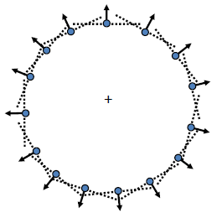
Marching Cubes
<number> / 100
Tangent plane for sample point s is found as follows:
  Find k-nearest neighbors of s.
  Apply principle component analysis on this set of close points (slide 65).
    Find the covariance matrix of the set.
    Take the eigenvectors of this matrix as the principal axes.
    Use the third best axis (w/ smallest eigenvalue) as the normal of the tangent plane, i.e. n_{i}.
    Use the mean of this point set as the centering point of the plane, i.e., o_{i}.
    The smaller the 3rd eigenvalue, the more confident the plane is, a is confident, b,c are not.
    ( )
    Darker = more ambiguous

Slide 47
Marching Cubes
<number> / 100
k-nearest points.
Brute force: O(k * N) when we have N samples. //10³ steps
Can be done in O(k * lgN) using Kd-trees. //10 steps.
Kd-tree: cells are axis-aligned bounding boxes.

Slide 48
Marching Cubes
<number> / 100
We efficiently (kd-tree) computed signed distance function F.
The only thing left is to find the intersection point on the square/cube edge:
Square:
Cube:

Slide 49
Marching Cubes
<number> / 100
We efficiently (kd-tree) computed signed distance function F.
The only thing left is to find the intersection point on the square/cube edge:
Square:
Cube:

Slide 50
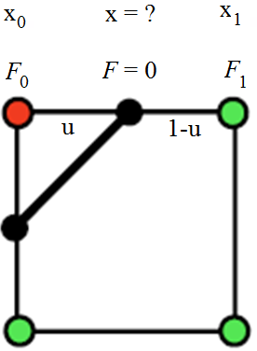
Marching Cubes
<number> / 100
We efficiently (kd-tree) computed signed distance function F.
The only thing left is to find the intersection point x on the square/cube edge:
F = F0 * (1-u) + F1 * u ➔ for F=0, u = F0 / (F0 – F1) //F is linear on edges.
x = x0 + u * (x1 – x0) ➔ use u computed above and locate x ☺

Slide 51
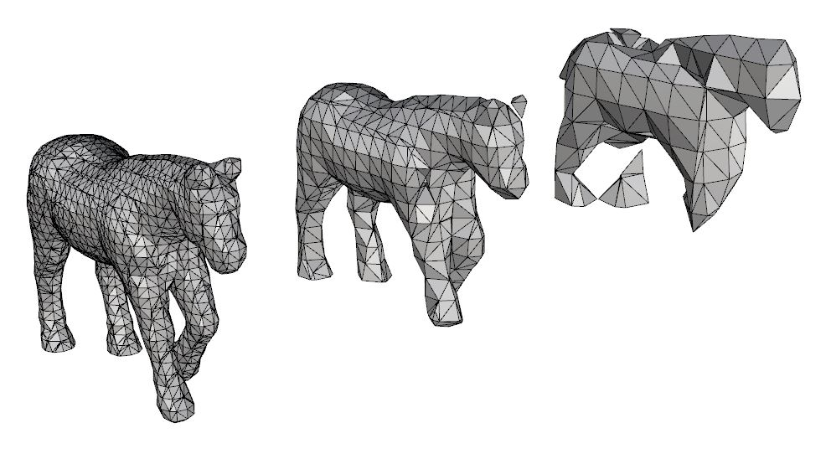
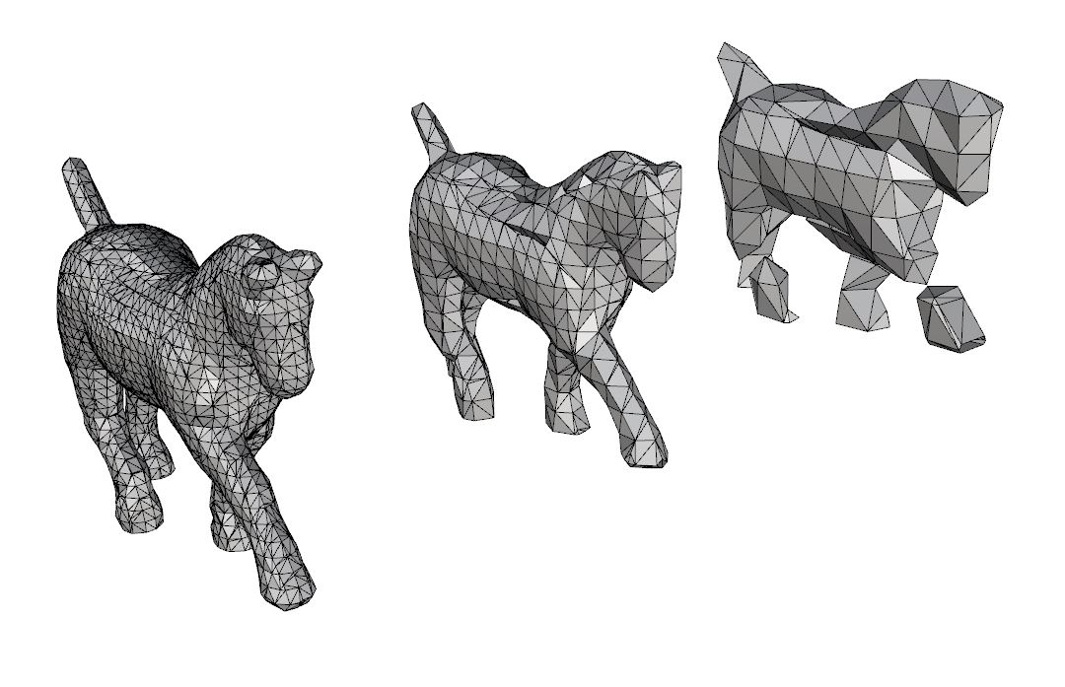
Marching Cubes
<number> / 100
Size of each voxel in the uniform grid determines level-of-detail.

Slide 52


Marching Cubes
<number> / 100
Size of each voxel in the uniform grid determines level-of-detail.

Slide 53


Marching Cubes
<number> / 100
Size of each voxel in the uniform grid determines level-of-detail.

Slide 54


Marching Cubes
<number> / 100
Size of each voxel in the uniform grid determines level-of-detail.

Slide 55

Marching Cubes
<number> / 100
In medical imaging, uniform grids are built based on CT/MRI scans.
CT scans generally come in DICOM format. Here is one way to convert them to NIfTI (nii) format, which can be parsed easily.
  Use dcm2nii.exe software: https://people.cas.sc.edu/rorden/mricron/dcm2nii.html
  E:\Postdoc\skull\mricron>dcm2nii.exe ..\CTsample\DICOM\4821\4823
Unzip output above somescan.nii.gz
Learn target intensity using a software like ITK-SNAP, say it is e.
  E.g., move cursor around skull and read intensities to decide on e.
Marching cubes will extract the level-set corresponding to value e.

Slide 56

Marching Cubes
<number> / 100
Read header and data.
  #include "nifti1.h"

Slide 57

Marching Cubes
<number> / 100
Read header and data.
  #include "nifti1.h"

Slide 58

Marching Cubes
<number> / 100
Create voxels useful to Marching Cubes,
e.g., the ones that contain skull intensities.

